Slide 1
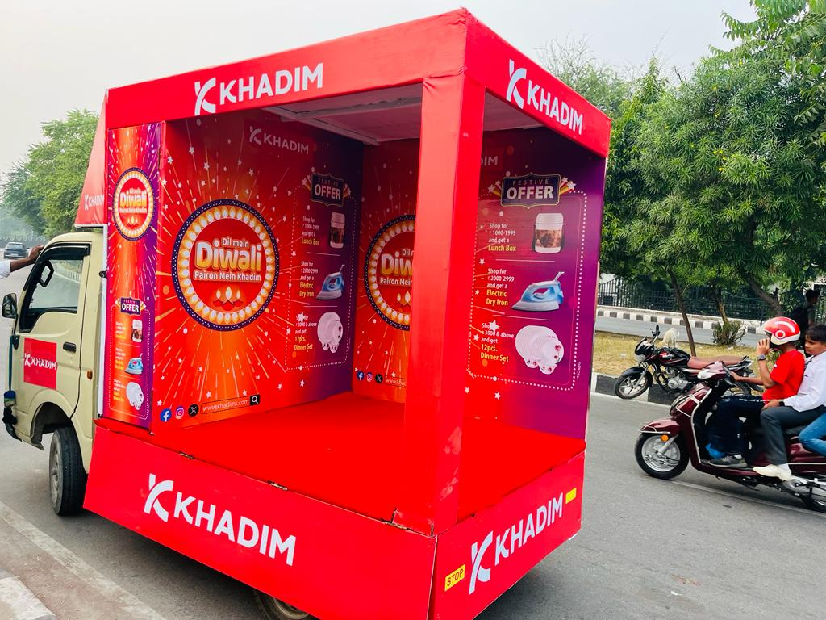
Mobile Van Branding

Slide 2
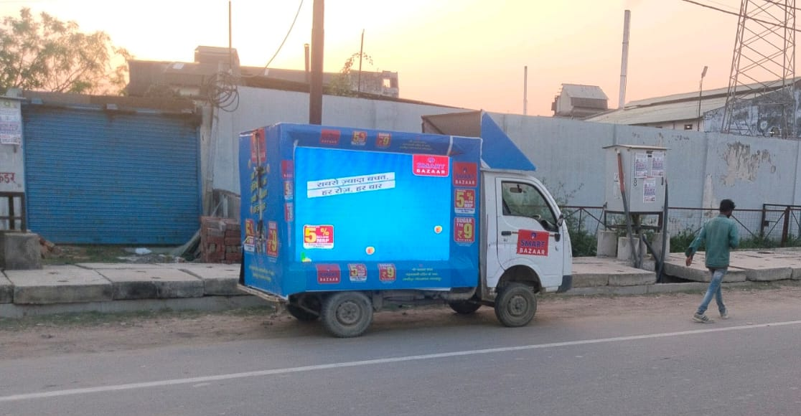
LED Van Branding

Slide 3
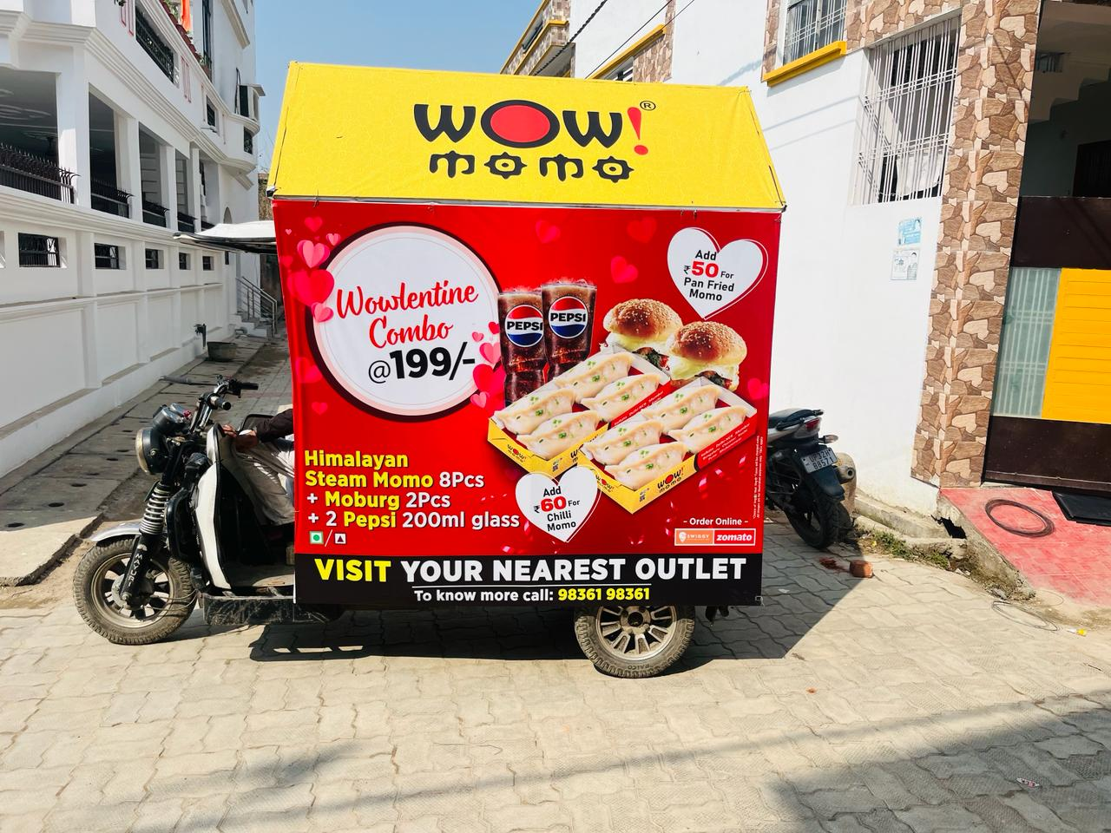
E-Rickshaw Branding

Slide 4
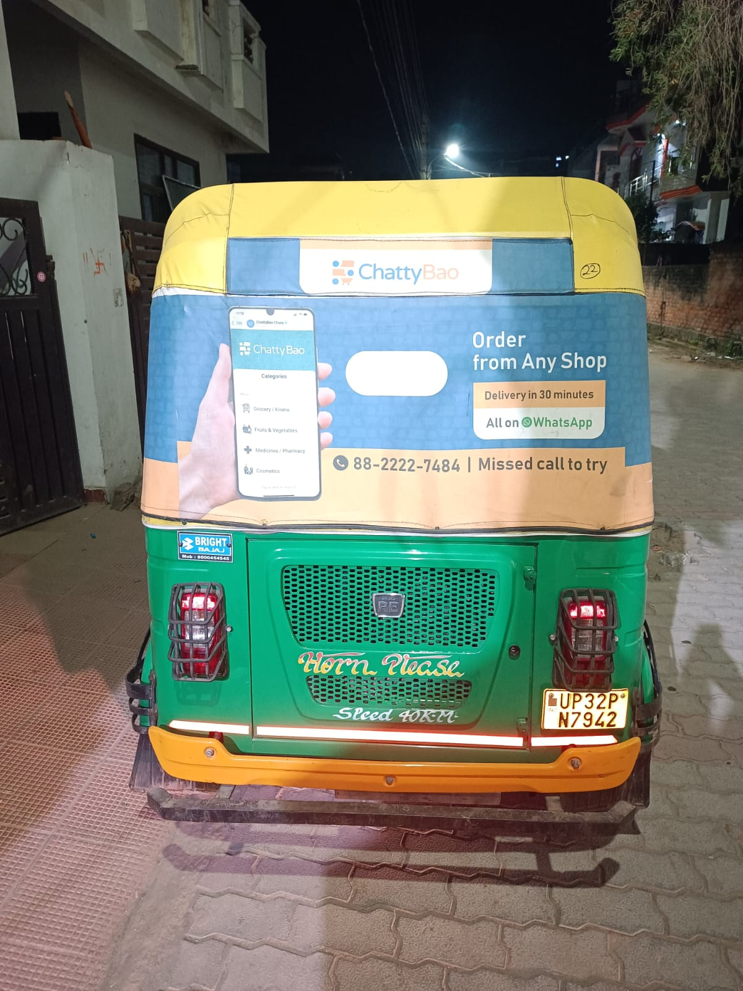
Auto Hood Branding

Slide 5
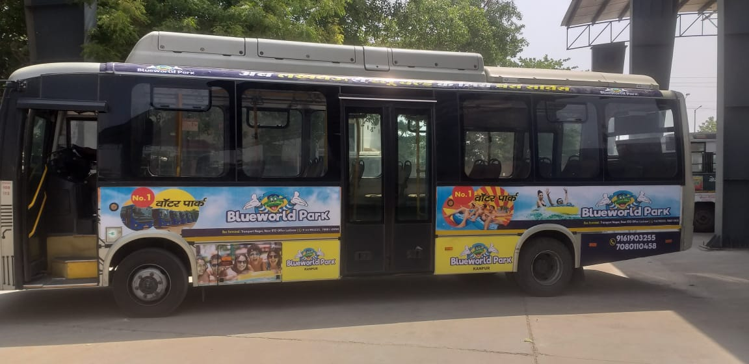
Bus Branding

Slide 6
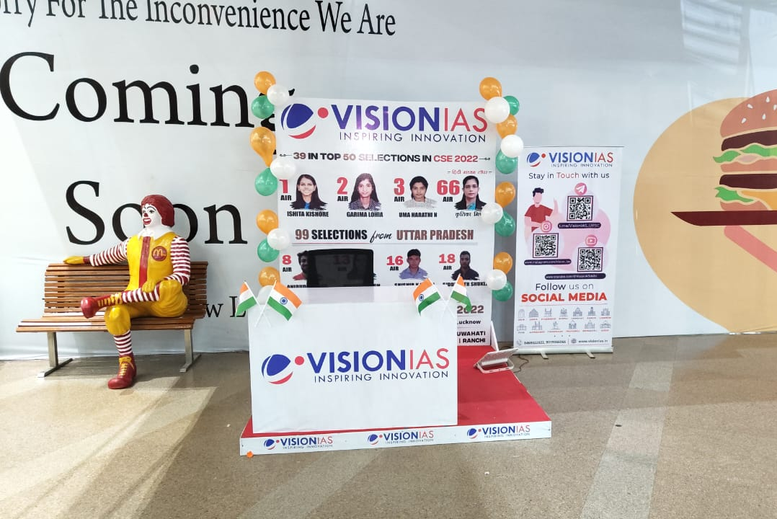
Mall Branding

Slide 7
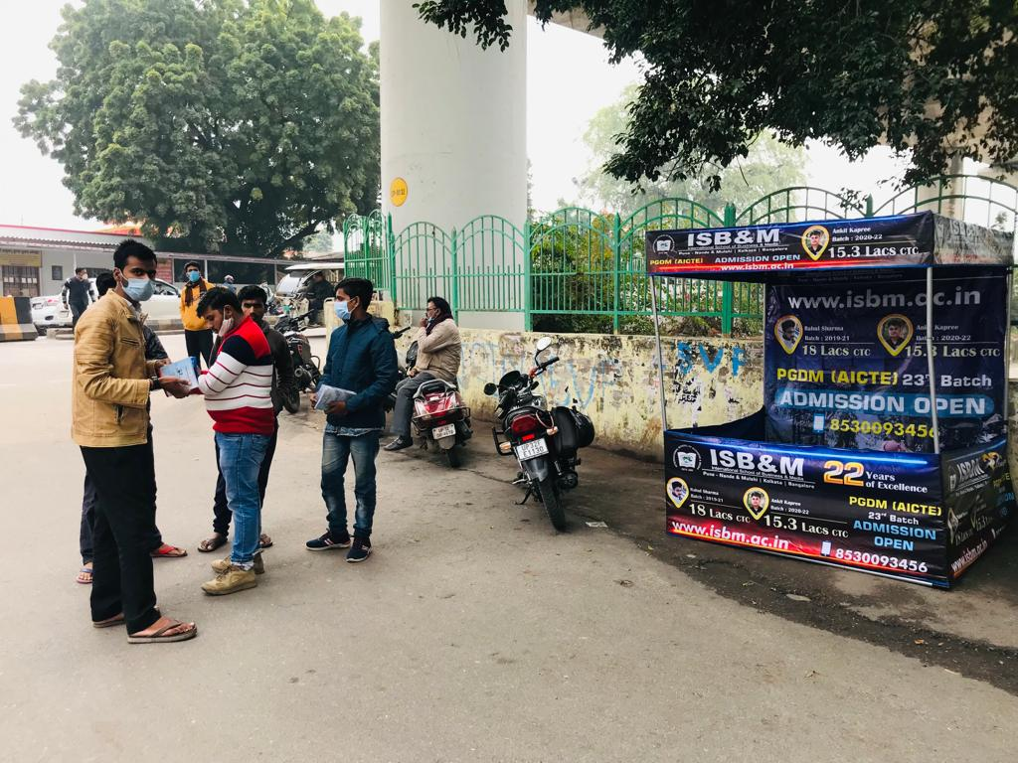
Canopy Branding

Slide 8
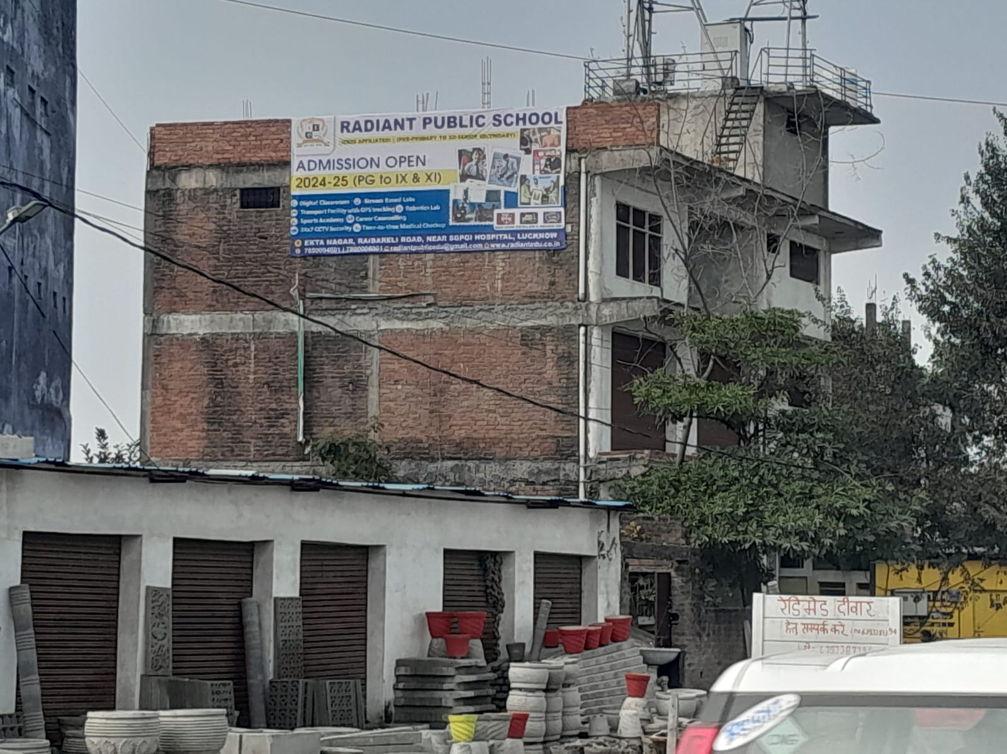
Wall Wrap Branding

Slide 9
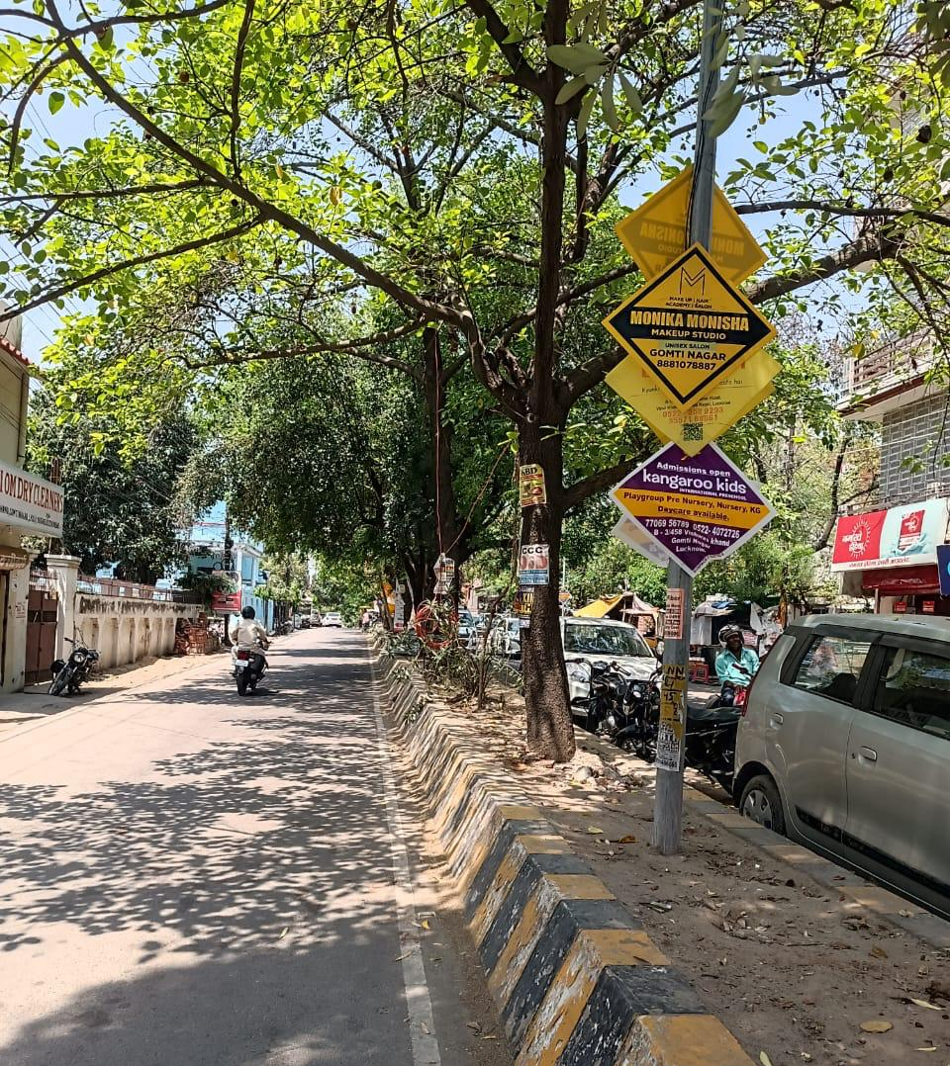
Sunpack Branding

Slide 10
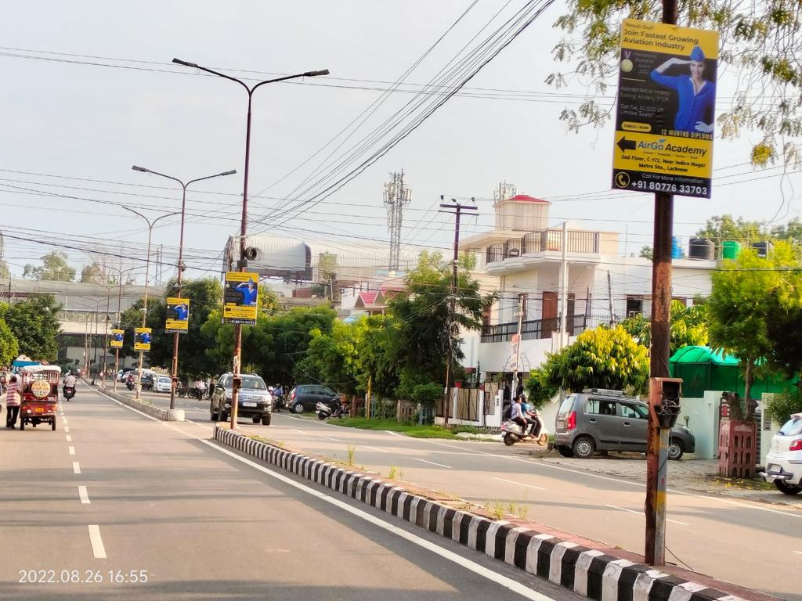
Pole Kiosk

Slide 11
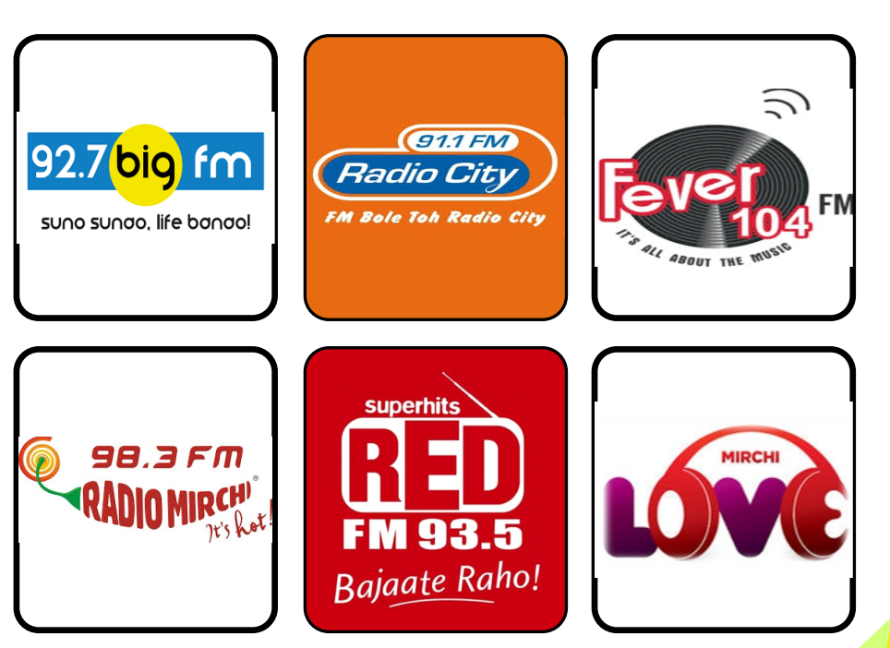
Radio Advertisement

Slide 12
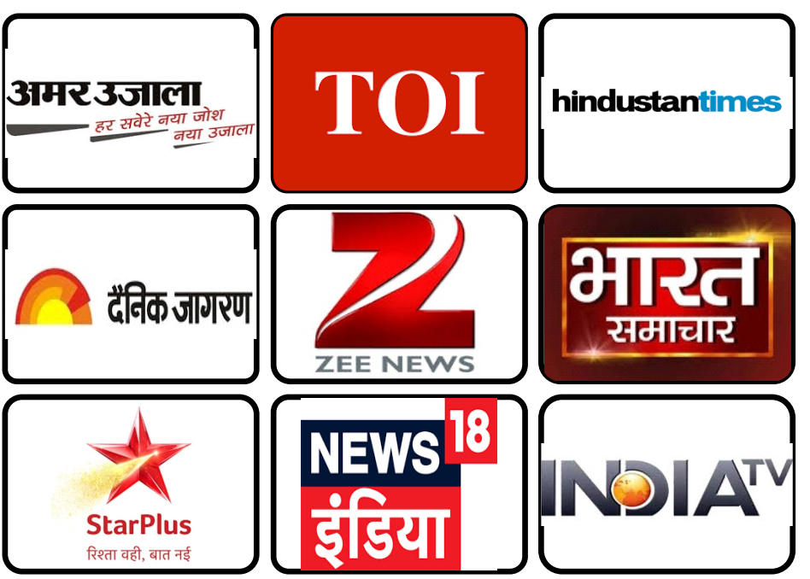
Newspaper & TV Advertisement

